Slide 1

Physical-informed Neural Networks
AI model for
Carbon Emission Estimation
HAN YUCHEN, A0298841M
Supervisor: Shuzhi Sam Ge
Apr. 12th 2025
©Copyright National University of Singapore. All Rights Reserved.

Slide 2

CONTENTS
1
Background & Introduction
2
Ship Motion model Design
3
Ship Motion Model Performance
4
Engine Model Design & Performance
5
Summary and Future Work
©Copyright National University of Singapore. All Rights Reserved.

Slide 3





1.2 Project Background
Motivation & Challenges
Methodological Background
A. Highly nonlinear dynamics Ship motion is strongly nonlinear and governed by multiple control inputs, making accurate modeling difficult.
White-box models:
Physically interpretable with well-defined structure, but suffer from modeling inaccuracies and incomplete parameterization.
B. Black-box models:
B. Complex mapping
As for engine states to emissions, SFOC is influenced by multiple nonlinear variables, which are hard to capture using rule-based methods.
Data-driven models with strong expressiveness, but lack physical constraints and are prone to instability under noise or unseen conditions.
C. Grey-box models:
Most existing studies focus on isolated modules (e.g., motion or SFOC), with few addressing the entire pipeline from motion → propulsion → carbon emissions in an integrated, physics-aware framework.
Integrate physical models with neural networks; use physics-based loss terms to improve generalization, stability, and interpretability.
C. Lack of
end-to-end architecture

Slide 4

1.2 Project Framework Introduction
Physical-informed Neural Networks AI model for Carbon Emission Estimation
Interpretable
AI model
Ship Motion model
Engine model
Physical Rules
Data
t
Res
+
Attention
u
Data Loss
Maritime data
Engine
Power
Simple
MLP
x
Engine data
v
+
Engine Speed
SFOC
$$δ$$
Adaptive weight
…
r
MMG model
Physical Loss
MCR
Knowledge
n
Diverse ship model
Data Loss
Engine model
White-box model:
MMG
Black-box model:
Res+Attention (+Phy)
Grey-box model:
PINN
©Copyright National University of Singapore. All Rights Reserved.

Slide 5
1.2 Innovations & Advantages
Aspect | This Work (Proposed Method) | Conventional Methods
Hybrid modeling (White+Black+Gray box) | Hybrid integration of MMG (white-box), Res+Attention (black-box), and PINN (gray-box) | Single black-box model, lacks physics grounding
Residual Attention Network | Residual network with attention mechanism to correct physics model errors | No structured correction of physics bias
Physics-guided Loss (PINN framework) | Joint optimization with Data Loss + Physics Loss to enforce physical consistency | Purely data-driven loss; prone to overfitting
Pipeline Coverage | End-to-end framework: Control → Motion → Engine → SFOC | Typically limited to one or two isolated modules
Interpretability | Each module is physically meaningful and traceable | Hard to interpret black-box predictions
Robustness | Maintains performance under noisy conditions using PINN constraints | Degrades quickly under data noise or anomalies
Innovation Summary | Multi-model fusion, attention-enhanced residual learning, physics-informed training, closed-loop SFOC modeling | Fragmented design, lacking coordination and physical insight
©Copyright National University of Singapore. All Rights Reserved.

Slide 6
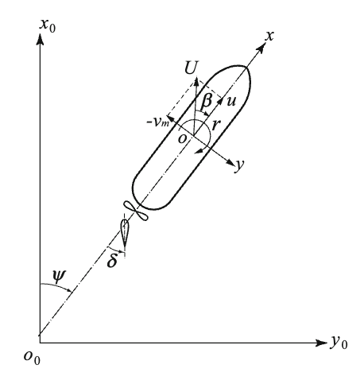
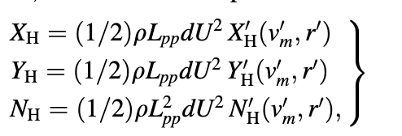
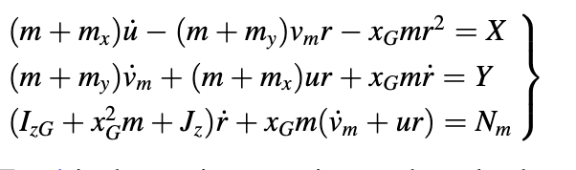
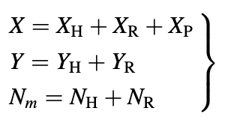
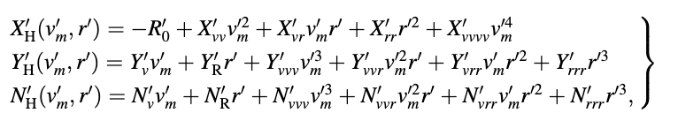
2.1 Ship Motion Model (White-box)
Maneuvering Modeling Group (MMG) model
Standard Model, consider the adaptability of hydrodynamic force data.
The coefficients are given by CFD hydrodynamic force simulation.
KVLCC2 model and the 7m-scale ship for validation.
Maneuvering Motion equations:
A. Hydrodynamic forces acting on ship hull
Where
are called the hydrodynamic derivatives on maneuvering.
©Copyright National University of Singapore. All Rights Reserved.

Slide 7
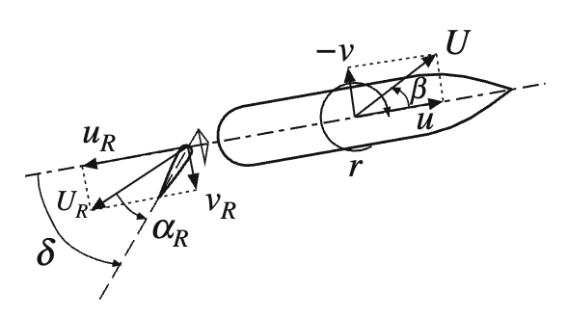
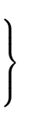
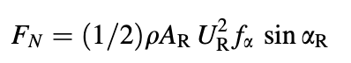
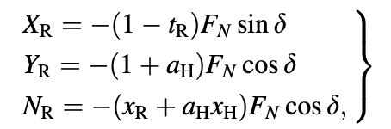
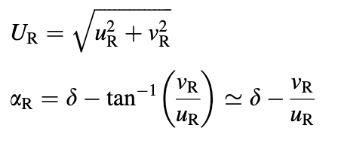
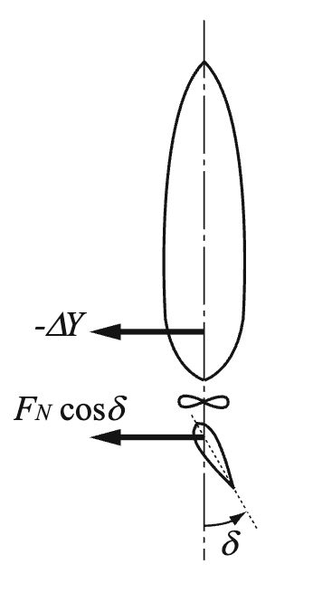
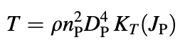
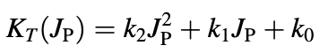
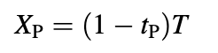
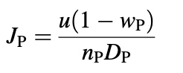
2.1 Ship Motion Model (White-box)
B. Hydrodynamic forces by Rudder
C. Hydrodynamic force due to propeller
$$u, v, r, nps → \dot{u}, \dot{v}, \dot{r} →Predicted Next state =Predict Current state+\left(\dot{u}, \dot{v}, \dot{r}\right) dt$$
©Copyright National University of Singapore. All Rights Reserved.

Slide 8


2.2.1 Ship Motion Model (Black-box)
Base: Extracting deep complex nonlinear features
ResidualAttentionNN
（Pure Data Driven）
t
7
-
512
BatchNorm
+
SiLU
+
Dropout
(0.3)
512
-
256
BatchNorm
+
SiLU
256
-
128
BatchNorm
+
SiLU
+
Dropout
(0.15)
128
-
64
+
SiLU
64
-
32
+
SiLU
x
Multihead
Attention
(dim=32, heads=4)
32
-
3
$$δ$$
u
…
n
v
+
t
7
-
64
SiLU
64
-
32
SiLU
r
x
$$δ$$
Residual:
Alleviate degradation problem
improve the training effect
…
Optimize
Data Loss
n
©Copyright National University of Singapore. All Rights Reserved.

Slide 9


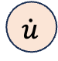


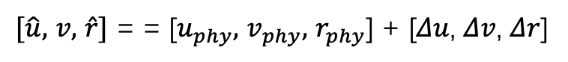
2.2.2 Ship Motion Model (Black-box)
MMG
Physical
model
state_phy
=
states_t
+
a * Δt
u_phy
Residual
Attention
NN
t
$$\dot{u}$$
x
v_phy
$$\dot{v}$$
u_correction
u
$$δ$$
r_phy
…
$$\dot{r}$$
v_correction
+
v
n
t
r_correction
r
x
$[\hat{u},$ $v,$ $\hat{r}]$ = = [$u_{phy},$ $v_{phy},$ $r_{phy}$] + [𝛥𝑢, 𝛥𝑣, 𝛥𝑟]
$$δ$$
ResidualAttentionNN
（Physical Rules Correction）
…
n
Data Loss
©Copyright National University of Singapore. All Rights Reserved.

Slide 10


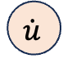
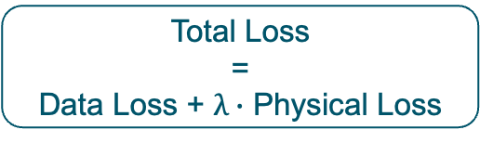
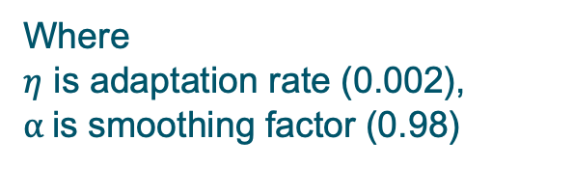

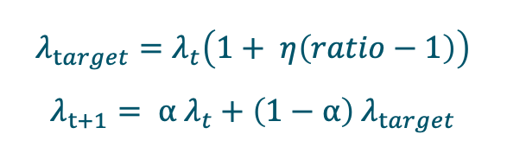
2.3 Ship Motion Model (Grey-box)
Physical-informed Neural Network(PINN)
u
Residual
Attention
NN
v
Data Loss
t
x
r
Total Loss
=
Data Loss + $λ∙$ Physical Loss
+
state_phy
=
states_t
+
a * Δt
$$δ$$
$$\dot{u}$$
u_phy
…
$$λ_{target}=λ_{t}\left(1+ η\left(ratio−1\right)\right)$$
$$λ_{t+1}= α λ_{t}+\left(1−α\right) λ_{target}$$
MMG
n
$$\dot{v}$$
v_phy
Physical
Loss
$$\dot{r}$$
r_phy
Where
$η$ is adaptation rate (0.002),
$α$is smoothing factor (0.98)
If loss_ratio > 1 → Data error is greater → Strengthen Physical supervision intensity.
If loss_ratio < 1 → Physical items dominate → Reduce physical supervision intensity.
©Copyright National University of Singapore. All Rights Reserved.

Slide 11
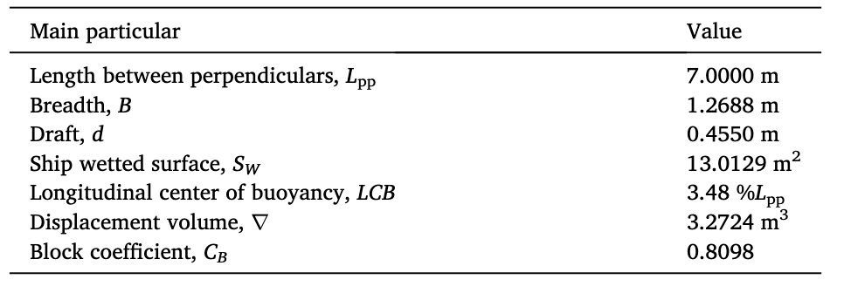
3.1 Model Performance
Dataset Introduction
The data used for modeling are from the Workshop SIMMAN, 2008.
The free-running model tests were conducted with the KVLCC2 ship model at Hamburg Ship Model Basin (HSVA).
‘ZAABB(P/S)’ where ‘AA’ represents the maximum rudder angle, ‘BB’ represents the switching angle, ‘P’ represents port side and ‘S’ represents starboard.
For instance, Z2010P denotes a zigzag maneuver with a switching angle of 10° performed with rudder angle starting from port side whose maximum value is 20°.
The nominal speed is set to 1.179 m/s;
Constant revolutions per minute (RPM) of propeller, which is 614 rpm.
The ship model is moving in the water of 6.0 m depth with the ratio of water depth to draft being 13.2, implying a deep-water condition.
Sampling interval is 0.05s, 11050 sample pairs.
Items: Time, x, y, psi, u, v, r, p, delta, n, thrust, torque
Dataset | Maneuver
Training-set | z1001, z1005, z1010P, z1010s，z1501, z2005, z2010s, z2505, z3005, z3505
Testing-set | z1505
©Copyright National University of Singapore. All Rights Reserved.

Slide 12
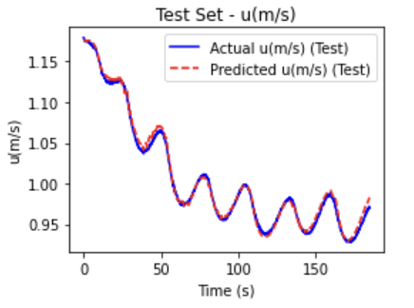
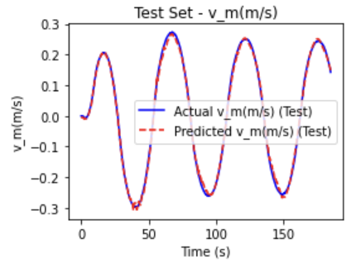
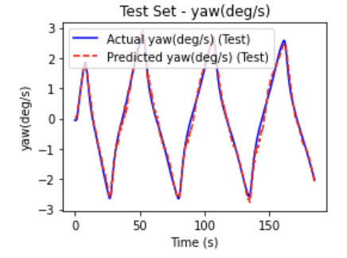
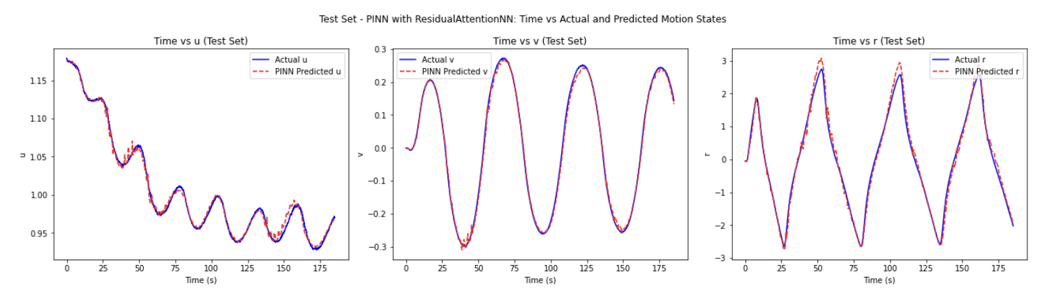


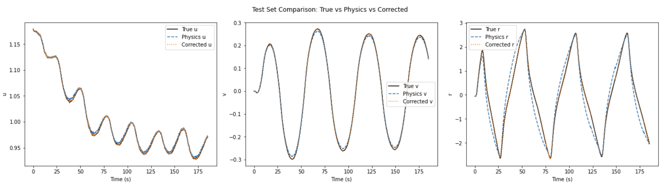
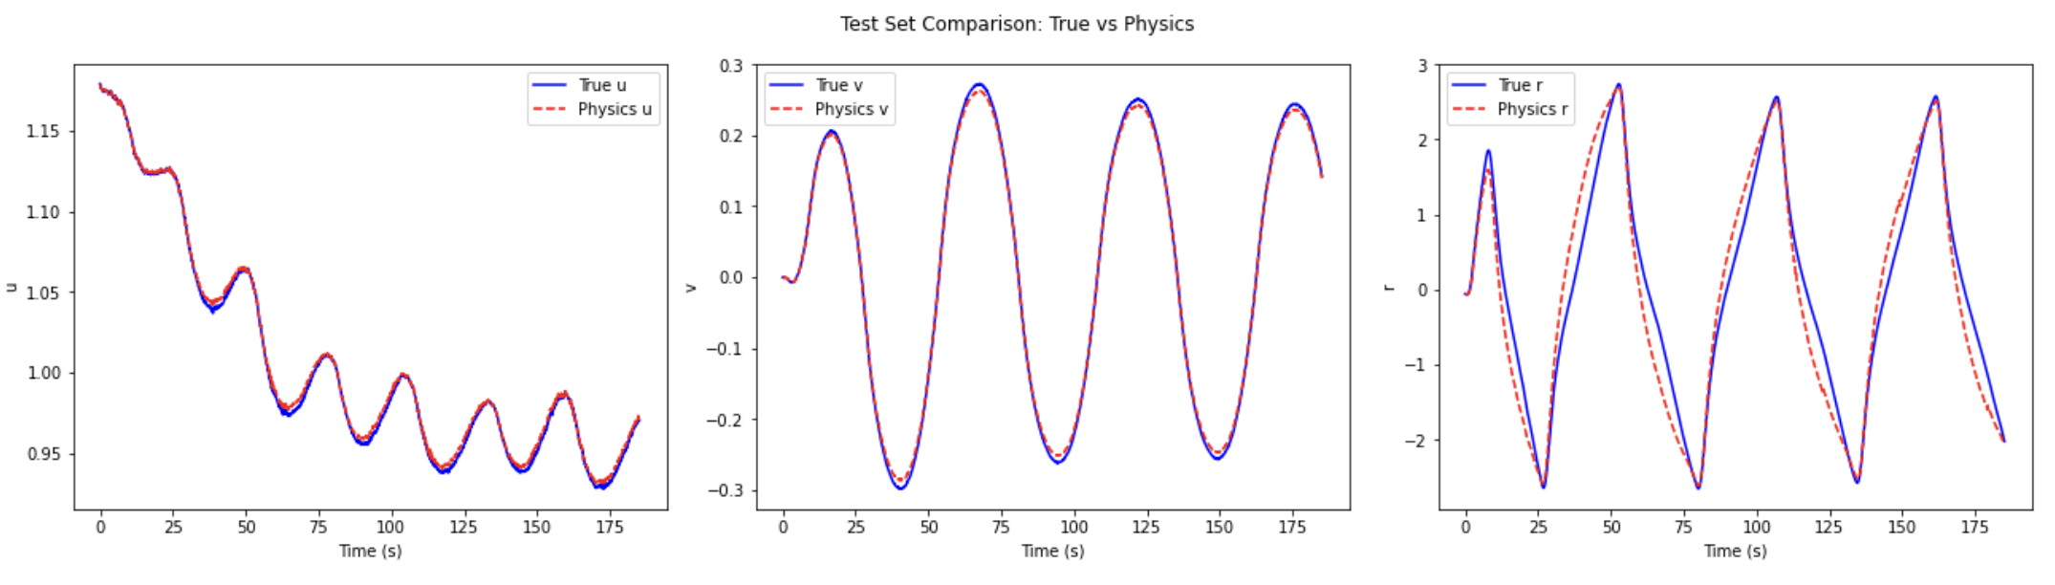
3.1 Model Performance Comparison
ResidualAttentionNN (Pure Data Driven) – Black box
Physical-informed Neural Network(PINN) – Grey box
- Interpretable AI model
ResidualAttentionNN (Phy-Correction) – Black box
Physical-Model (MMG) – White box
- Interpretable AI model
©Copyright National University of Singapore. All Rights Reserved.

Slide 13
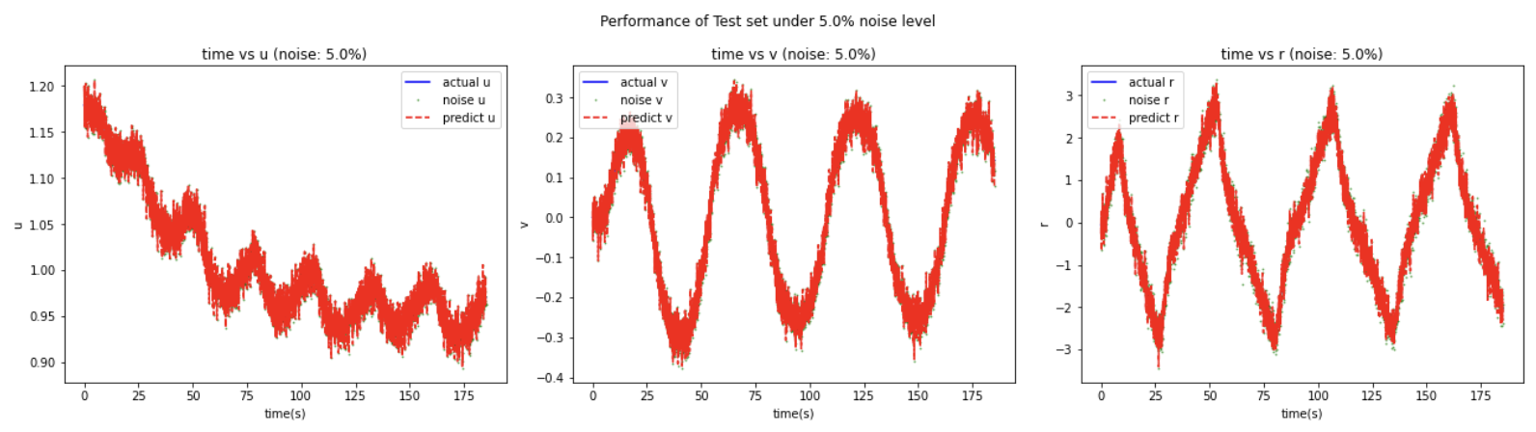
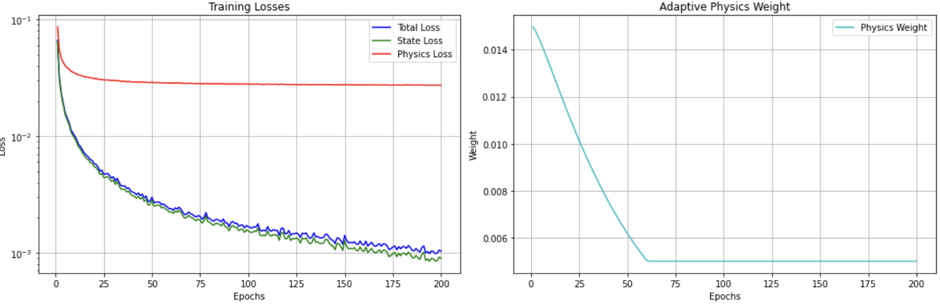
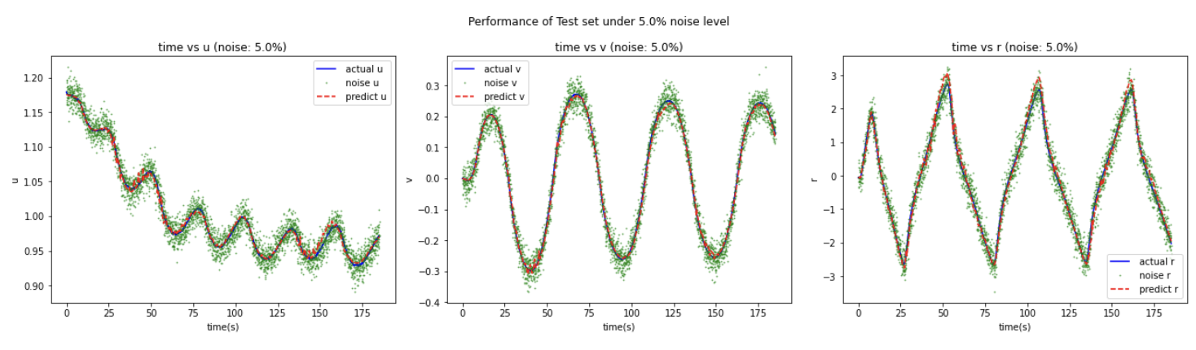
3.2 Robustness Performance
ResidualAttentionNN (Phy-Correction) – Black box
PINN Training Process
Physical-informed Neural Network(PINN) – Grey box
©Copyright National University of Singapore. All Rights Reserved.

Slide 14
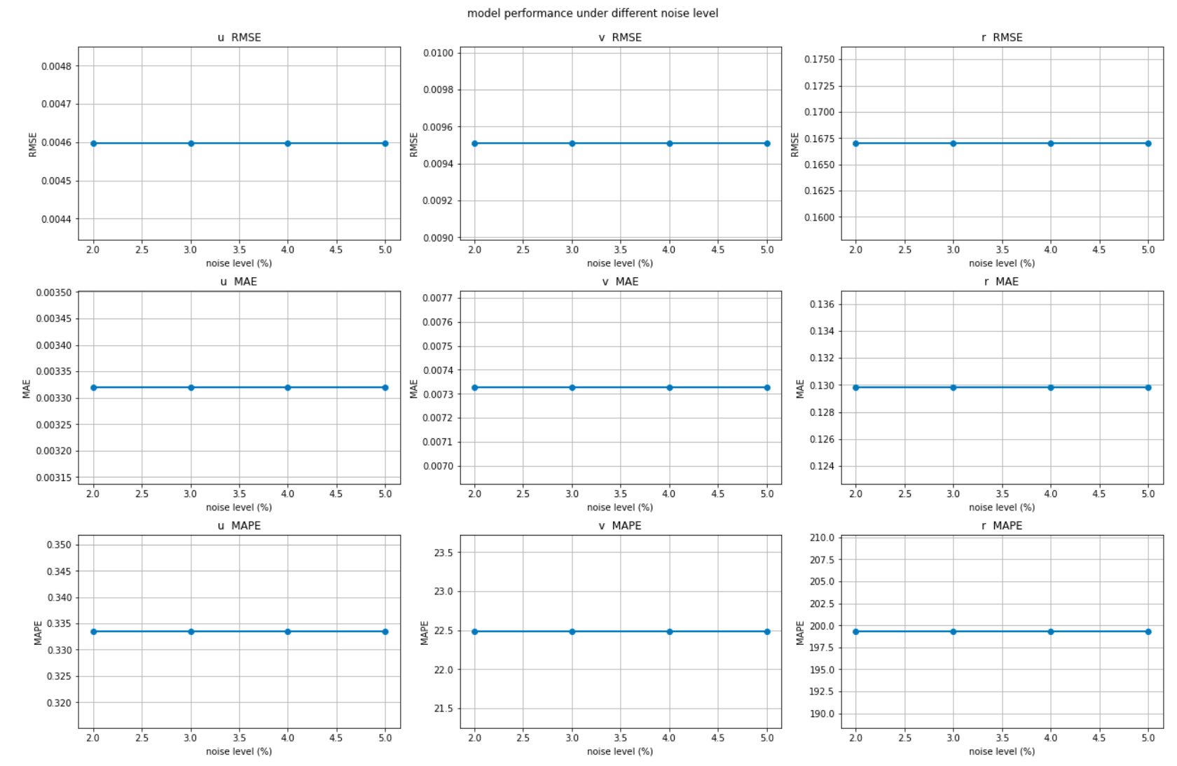
3.2 Robustness Performance
Physical-informed Neural Network(PINN) – Grey box Robustness Performance for u
Noise level | MSE | RMSE | MAE | MAPE(%)
2% | 2.1134398 e-05 | 0.00459722 | 0.00331979 | 0.3335031
3% | 2.1134398 e-05 | 0.00459722 | 0.00331979 | 0.3335031
4% | 2.1134398 e-05 | 0.00459722 | 0.00331979 | 0.3335031
5% | 2.1134398 e-05 | 0.00459722 | 0.00331979 | 0.3335031
ResidualAttentionNN (Phy-Correction) – Black box Robustness Performance for u
Noise level | MSE | RMSE | MAE | MAPE(%)
2% | 2.4882205 e-05 | 0.004988212 | 0.00398339 | 0.39763698
3% | 5.6499066 e-05 | 0.00751659 | 0.00599381 | 0.59817094
4% | 0.00010058 | 0.01002912 | 0.00798836 | 0.797843
5% | 0.0001593 | 0.01262145 | 0.01006661 | 1.003022
Physical-informed Neural Network(PINN) – Grey box
Robustness Performance for u, v, yaw
©Copyright National University of Singapore. All Rights Reserved.

Slide 15
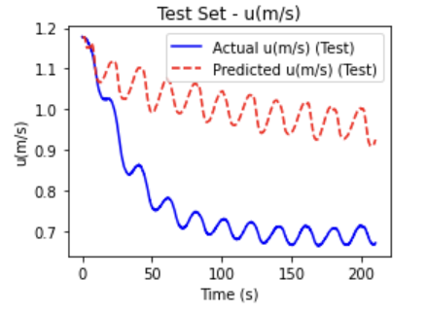
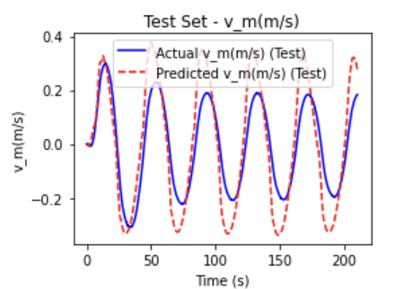
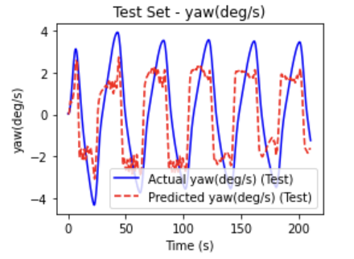
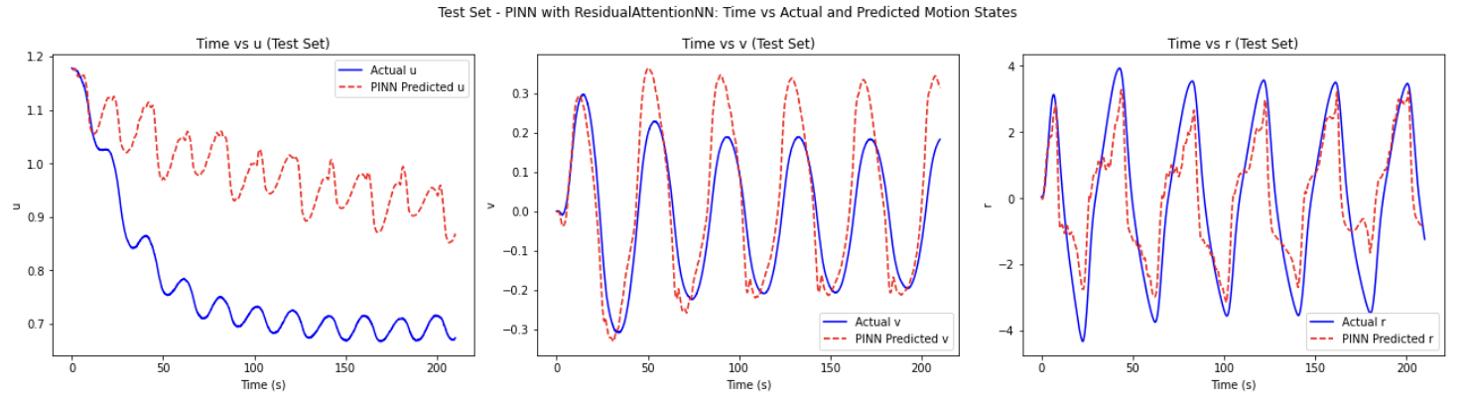
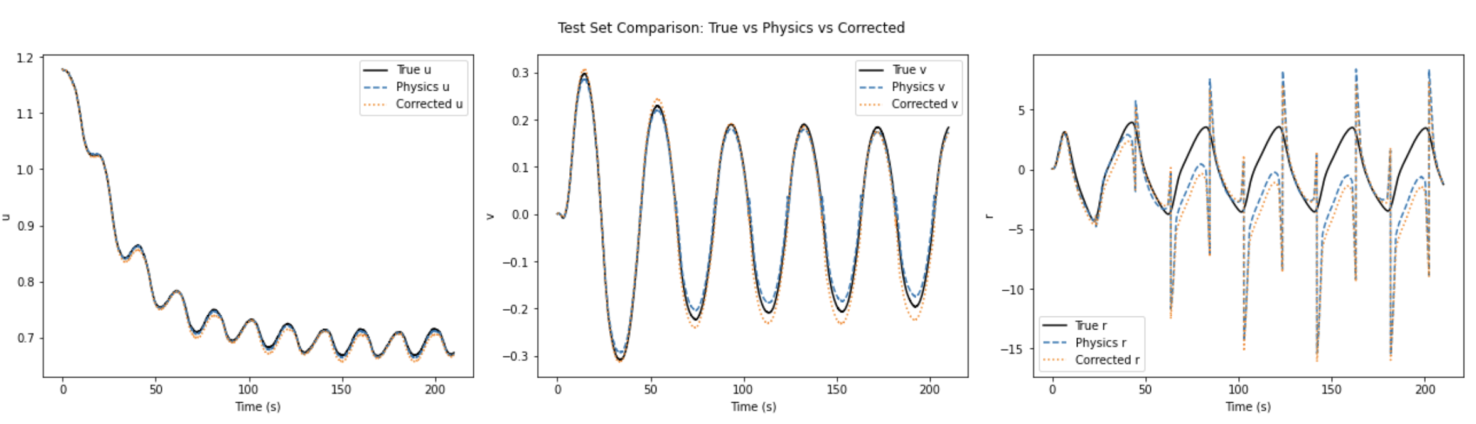
3.3 Generalization ability of the model
ResidualAttentionNN (Pure Data Driven)
– Black box
Physical-informed Neural Network(PINN)
– Grey box
Dataset | Maneuver
Training-set | z1001, z1005, z1010P, z1010s，z1501,
Testing-set | z3505
ResidualAttentionNN (Phy-Correction) – Black box
©Copyright National University of Singapore. All Rights Reserved.

Slide 16
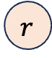
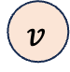
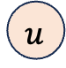

4.1 Engine Model Design
From Ship motion model to Engine Model:
longitudinal speed u, lateral speed v, yaw rate r, propeller speed Np as inputs.
Calculated by physical formula, propeller torque Tp and main engine power P_engine, thus realizing the natural transition from the motion state to the fuel consumption model.
t
Interpretable
AI model
Physical
Equations
$$u$$
Engine
Power
Simple
MLP
x
$$v$$
Engine Speed
SFOC
$$δ$$
…
$$r$$
MCR
n
Data Loss
©Copyright National University of Singapore. All Rights Reserved.

Slide 17
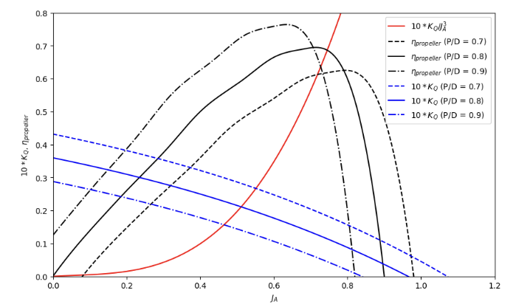
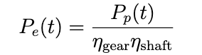
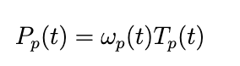
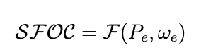

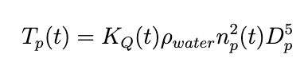
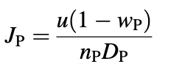
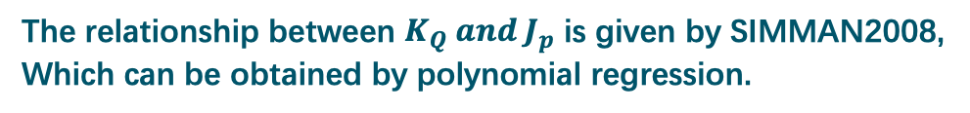
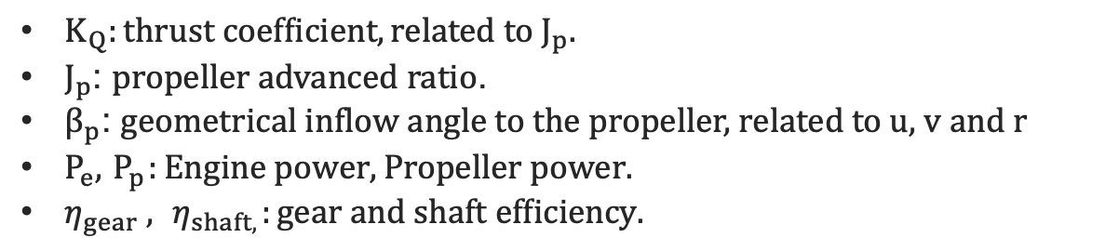
4.1 Propeller to Engine Model
Data Driven model
$$K_{Q}= −0.0119∙{J_{p}}^{3} − 0.0074∙{J_{p}}^{2}− 0.0186∙J_{p}+ 0.0370$$
The relationship between $K_{Q} and J_{p}$ is given by SIMMAN2008,
Which can be obtained by polynomial regression.
$K_{Q}:thrust coefficient, related to{ J}_{p}.$
$J_{p}\text{: }\text{propeller} \text{advanced} \text{ratio}\text{.}$
$β_{p}$: geometrical inflow angle to the propeller, related to u, v and r
$P_{e},{ P}_{p}:Engine power, Propeller power.$
$η_{gear} ,{ η}_{shaft,}:gear and shaft efficiency.$
©Copyright National University of Singapore. All Rights Reserved.

Slide 18
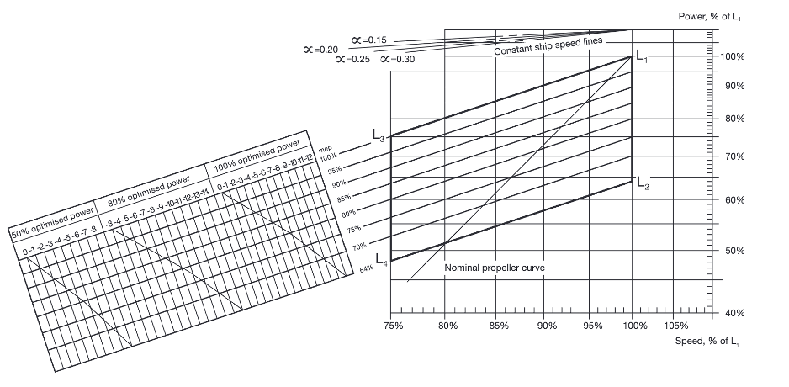
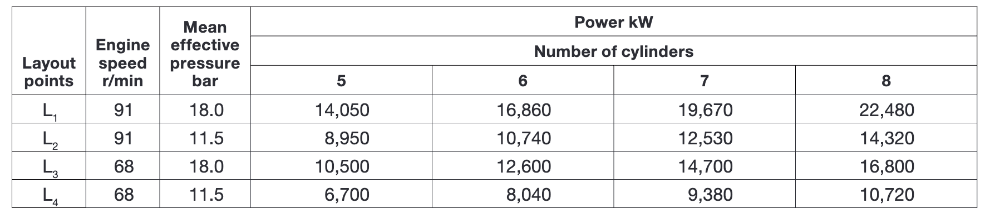





4.1 Propeller to Engine Model
Dataset Introduction
SIMMAN2008
7m-scale
$$（1）λ=\frac{L_{ship}}{L_{model}}=\frac{320}{7}=45.71$$
SFOC for S70MC6 with fixed pitch propeller
$${（2）n}_{ship}​=λ^{−1/2}⋅n_{model}=90.8 rpm$$
Froude scaling law
$（3）u=0.96∼1.17m/s$ (7m-scale)
Typical economic speed of VLCC (≈13 knots)
Cruise at full speed (≈15.5 knots)
$$ω_{e},P_{e}$$
in 320m-Full-scale
$${\left(4\right) P}_{ship}​​​=λ^{3.5}⋅P_{model }​\text{≈}\text{20}Mw​−30Mw$$
Find Fitting Engine：
MAN- S70MC6
©Copyright National University of Singapore. All Rights Reserved.

Slide 19


4.2 Model Performance
heatmap
Engine
Power
Simple
MLP
Engine Speed
SFOC
MCR
Data Loss
MSELoss = criterion(SFOC_pred, SFOC_train), SFOC at nominal MCR (g/kWh) = 171, prediction error is 0.18% ~ 0.39%.
©Copyright National University of Singapore. All Rights Reserved.

Slide 20
5.1 Summary
Physical-informed Neural Networks AI model for Carbon Emission Estimation
Interpretable
AI model
Ship Motion model
Engine model
Physical Rules
Data
t
Res
+
Attention
u
Data Loss
Maritime data
Engine
Power
Simple
MLP
x
Engine data
v
+
Engine Speed
SFOC
$$δ$$
Adaptive weight
…
r
MMG model
Physical Loss
MCR
Knowledge
n
Diverse ship model
Data Loss
Engine model
White-box model:
MMG
Black-box model:
Res+Attention (+Phy)
Grey-box model:
PINN
©Copyright National University of Singapore. All Rights Reserved.

Slide 21
5.1 Summary
1. Research objectives and general ideas
(1) To solve the two core problems of ship motion state prediction and carbon emission estimation.
(2) Build an end-to-end modeling framework that integrates physical modeling and neural network.
2. Model structure design
A collaborative modeling system of white box (MMG)+ black box (Res+Attention)+ gray box (PINN) is constructed to achieve both high accuracy and interpretability.
3. Training strategy and system flow
(1) Loss design: jointly optimize Data Loss and Physics Loss to prevent non-physical behavior..
(2) Closed-loop characteristic: Support dynamic and end-to-end SFOC estimation (motion state → engine power → SFOC).
4. Experimental effect and engineering significance
Experiments show that the model has good prediction performance and robustness, which provides technical support for intelligent shipping and green low-carbon applications.
©Copyright National University of Singapore. All Rights Reserved.

Slide 22




5.2 Future Work
Improving Generalization
Capability
Incorporating Environmental Disturbance Modeling
Multi-vessel Training
KVLCC2 → container ships, bulk carriers, etc.,
hybrid modeling framework with strong cross-vessel generalization capability.
waves, wind, currents, and shallow water effects.
enhance the model's stability and performance under realistic and complex sea conditions.
Future
Work
Transfer Learning with
Real-Ship Operational Data
Introducing Additional Constraint Terms for Improved Generalization
conservation constraints (e.g., mass or momentum conservation), first-order and second-order derivative penalties.
temporal regularization.
real-world data from AIS logs, onboard sensors, and digital twin platforms
to fine-tune the model and improve its real-world predictive accuracy.
©Copyright National University of Singapore. All Rights Reserved.

